Slide 1
CAPSTONE PROJECT – SALES ANALYSIS

Slide 2
OBJECTIVE – The Objective of this POWER BI report is to create a visually appealing and user friendly
Dashboard that communicates key performance metrics for NORTHWIND TRADERS efficiently.
ANALYSIS SCOPE – The analysis will focus on various aspects of the sales analysis, customer
Segmentation, shipping of the products, employ management etc, it will use the data of all the
Products and employees and let them know which product scored higher, and which region excel
In NORTHWIND TRADER’S charts.
GOAL – The report will empower stakeholders to make data driven decisions by offering valuable
Insights and facilitating data exploration through interactive visualizations and dynamic filters.

Slide 3
POWER BI Problem Statements

Slide 4
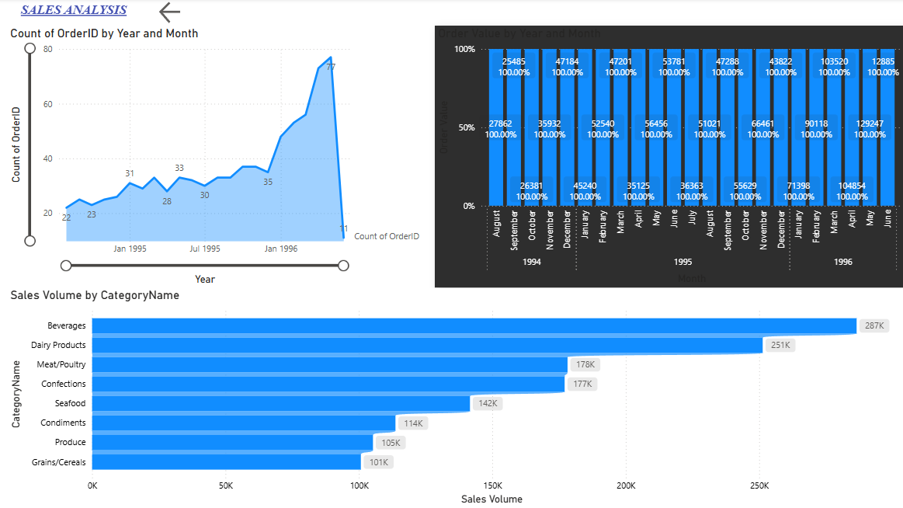

Slide 5
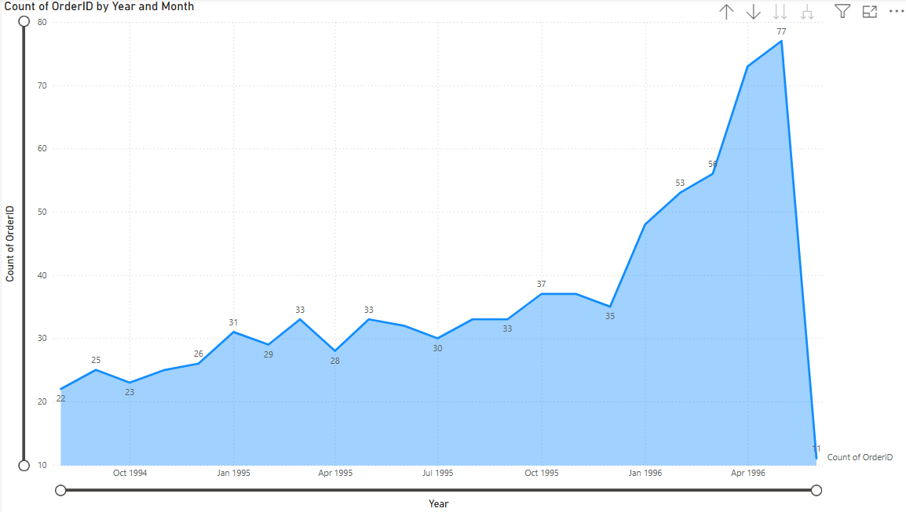
How does order volume change over time? Can we create a time series chart or stacked bar chart to visualize it?
As we can see the order volume shows highs and lows in certain years, but is booming in the year Apr 1996.

Slide 6
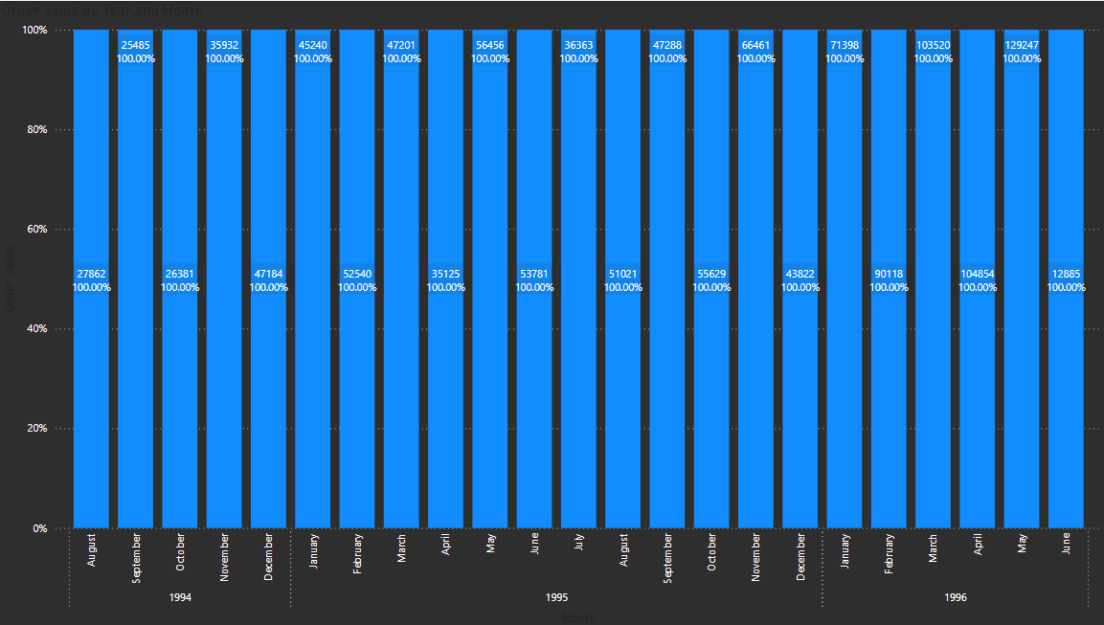
What is the distribution of order values? Can we create a histogram or box plot to display it?
It shows that the order values in each month on the year, are increasing rapidly till June 1996.

Slide 7
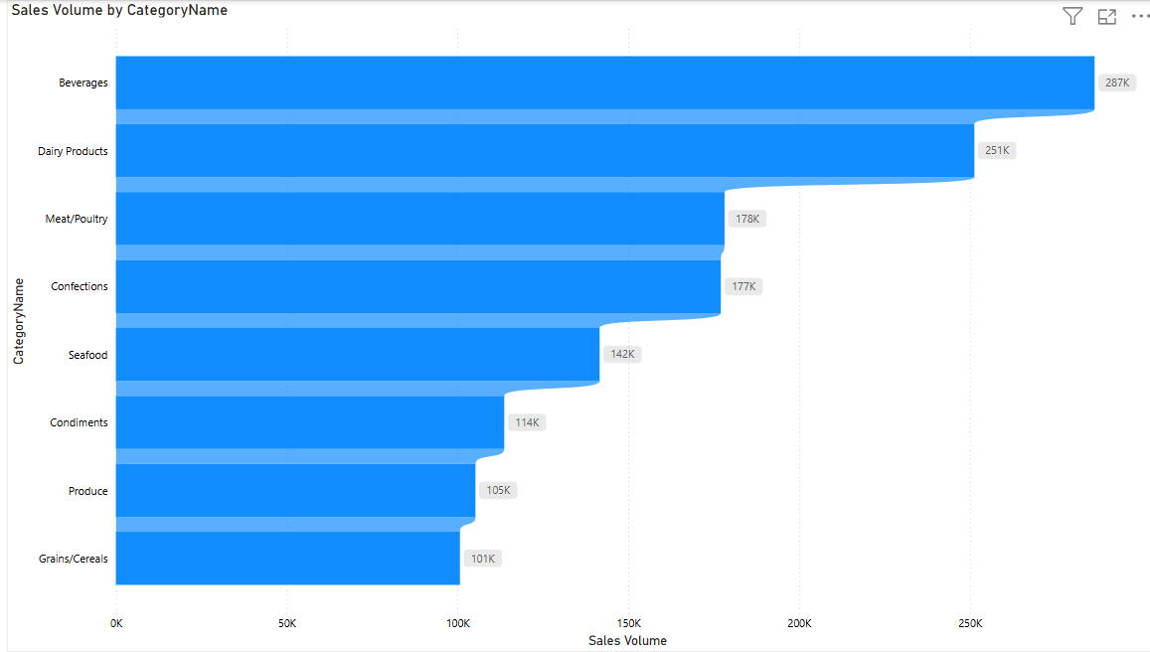
How does the sales volume vary across different product categories? Can we create a bar chart or treemap to display it?
As we can see the maximum sales goes to Beverages and minimum sales goes to Grains.

Slide 8
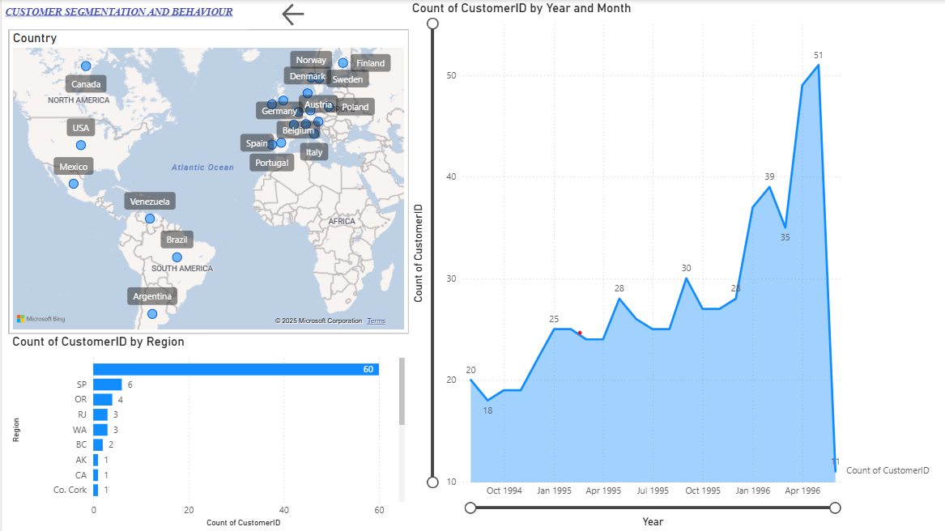

Slide 9
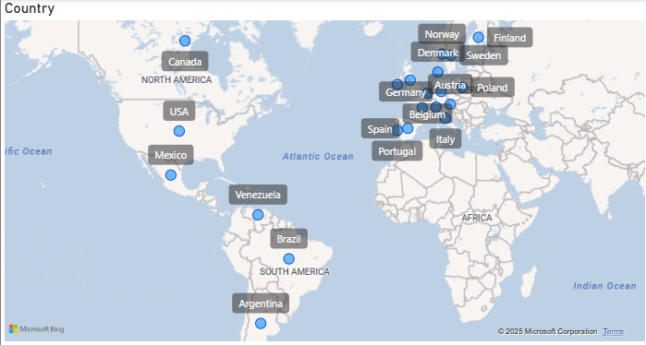
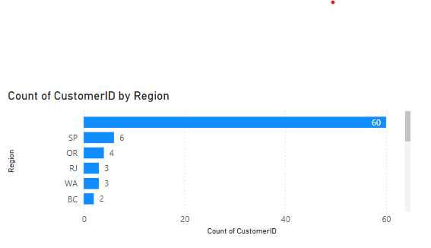
How does customer distribution vary across different regions or customer segments? Can we visualize it on a map or bar chart?
The points with more area coverage have, here Austria, Germany, Belgium and nearby cities have more customers. And also the region with the more customers is SP.

Slide 10
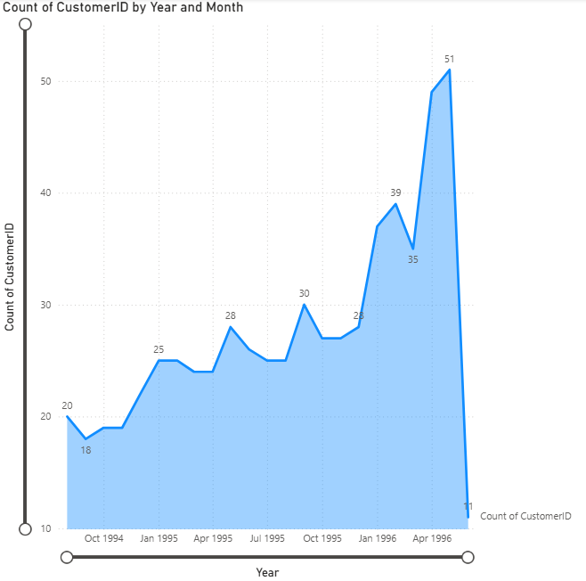
What is the trend in customer acquisition over time? Can we create a line chart or area chart to display it?
As we can see the customer acquisition shows highs and lows in certain years, but is booming in the year Apr 1996.

Slide 11
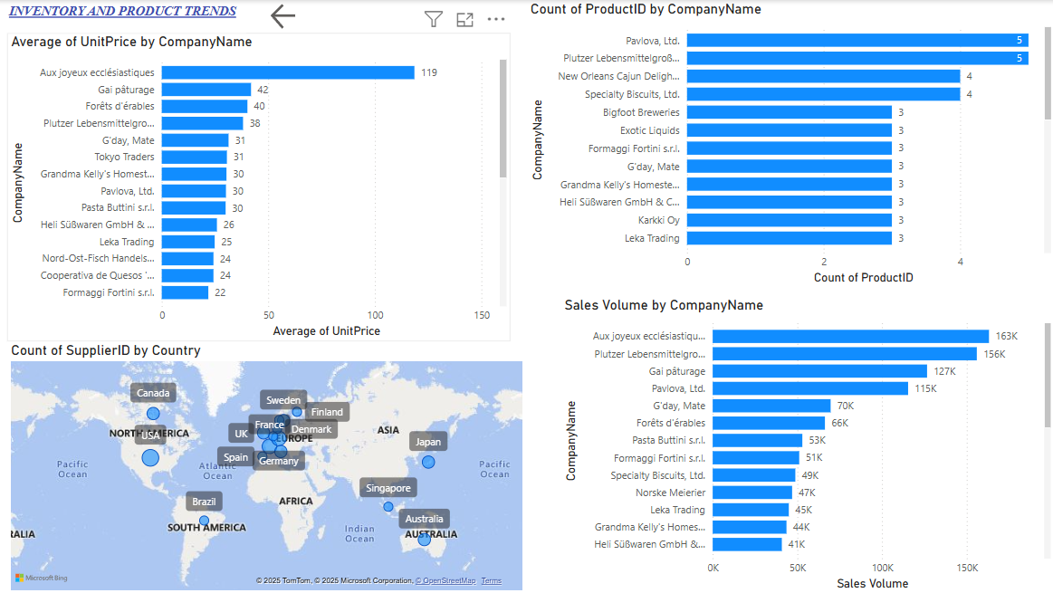

Slide 12
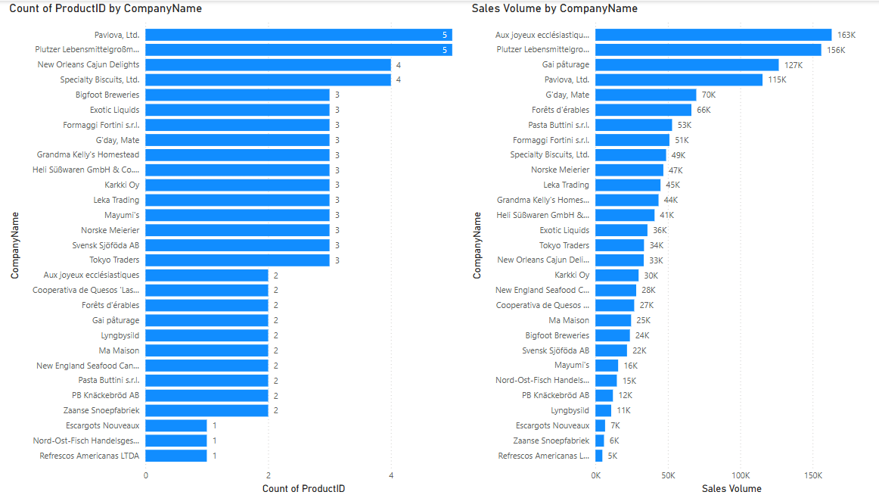
What is the distribution of supplier ratings or performance metrics? Can we create a bar chart or radar chart to visualize it?
Here we can see that the supplier rating is more for Pavlova, Ltd. And for performance metrics the sales were maximum for Aux Joyeux company.

Slide 13
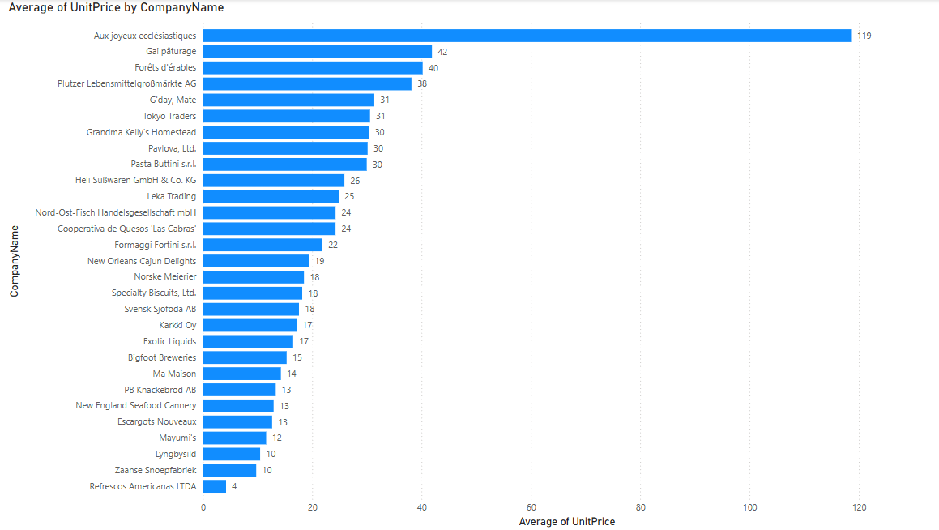
How does the cost or pricing structure vary across different suppliers? Can we create a box plot or stacked bar chart to display it?
As we can see, there’s average calculated for pricing among suppliers, so here Aux Joyeux have more edge among different suppliers.

Slide 14
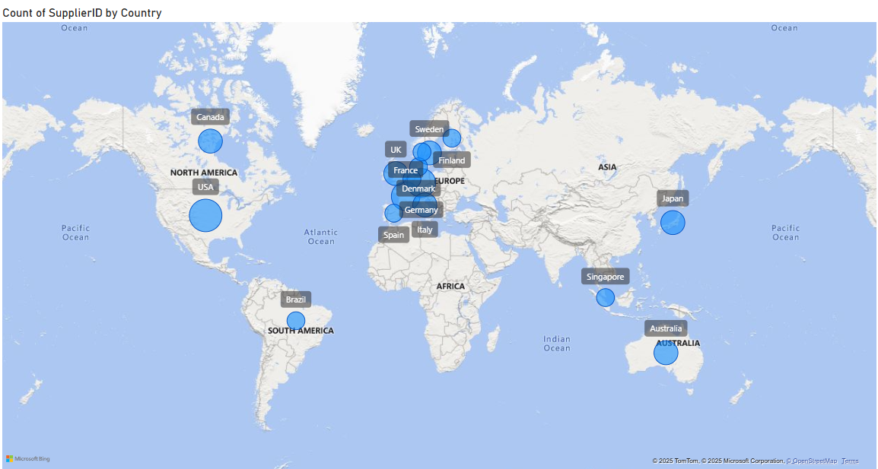
Can we visualize the geographical distribution of suppliers using a map or bubble chart?
So here we can see most of the bubbles or suppliers lies in Europe region and the biggest bubble or supplier count is in USA.

Slide 15
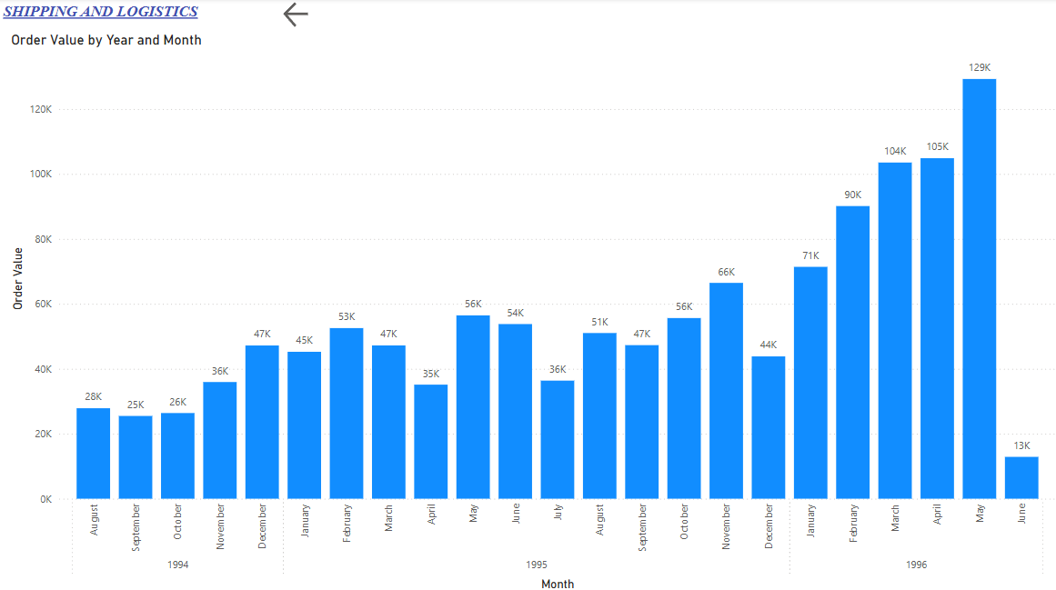

Slide 16
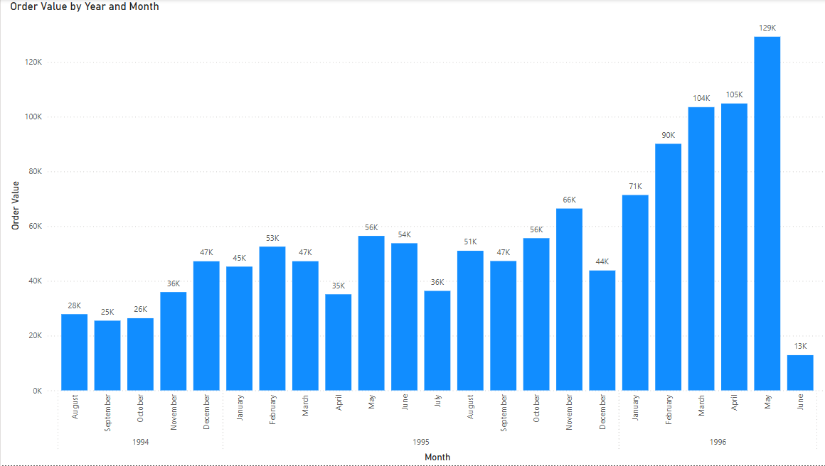
Can we visualize the average order processing time or shipping duration using a bar chart or box plot?
Here the order value is given with may 1996 as the highest order number.

Slide 17
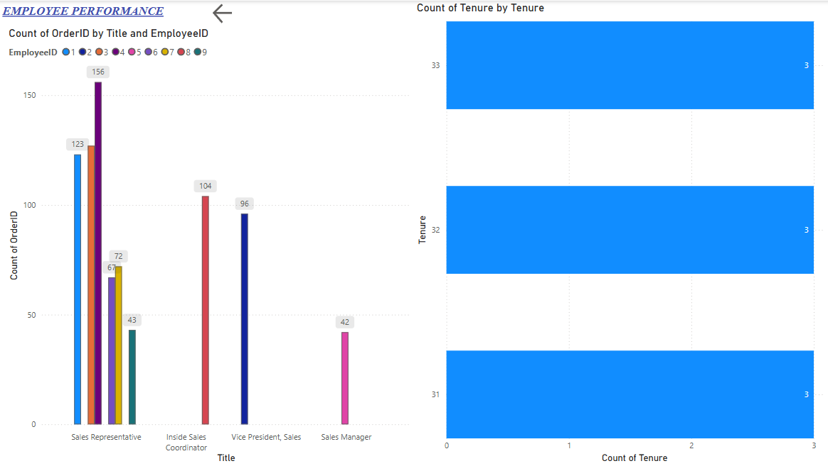

Slide 18
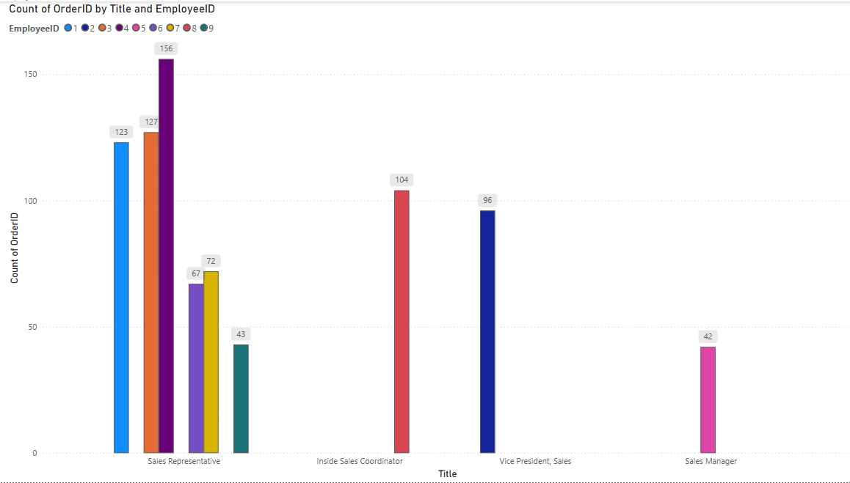
How does employee productivity vary across different departments or job roles? Can we create a stacked bar chart or grouped column chart to visualize it?
In sales the employees, have more productivity in terms of other roles, and the sales department have the more employees working too.

Slide 19
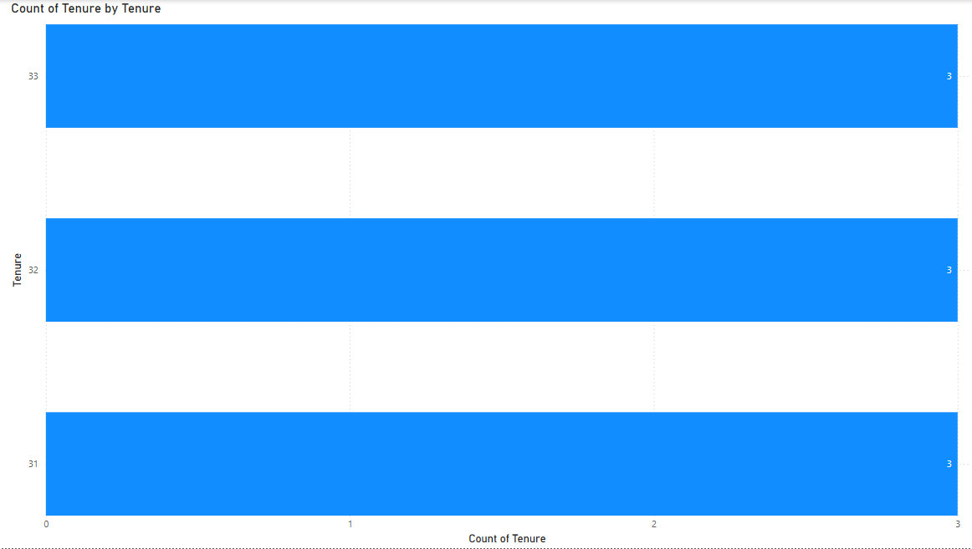
What is the distribution of employee tenure? Can we create a histogram or box plot to display it?
Here the distribution is same for all the employees.

